Slide 1


Problem Solving with the Internet of Things and Python
Unit 5 - WiFi Connectivity
Notes:
Note from Doug. If you are using these materials, you can remove the CWRU logo and replace it with your own, but please retain the CC-BY logo on the first page as well as retain the acknowledgements page(s).

Slide 2
Lab 9
Intro to Wifi and HTTP

Slide 3
What is Wi-Fi?
You were introduced to Wi-Fi back in Unit 1.
Everyone knows what Wi-Fi is!
Right?
Maybe?
Maybe not…

Slide 4

What Wi-Fi is not.
Wi-Fi is not an acronym. It is not short for WIreless FIdelity or anything else. Wi-Fi was created in 1999 as a brand name to replace “IEEE 802.11b Direct Sequence.”
Interbrand, the consulting firm that created the name as a play on “hi-fi”, also created the Wi-Fi logo
source: https://www.cablefree.net/wireless-technology/history-of-wifi-technology/

Slide 5
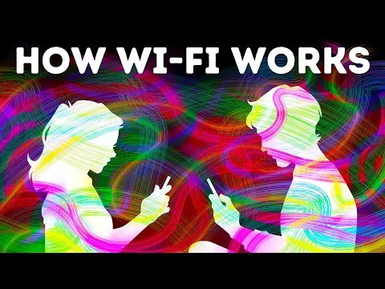
Intro to Wi-Fi

Slide 6
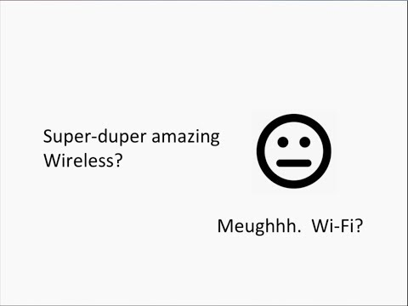
A little more about Wi-Fi

Slide 7
Who controls Wi-Fi?
Wi-Fi is really another name for an IEEE 802.11 protocol which refers specifically to wireless local area networks.
The IEEE created and maintains the standards for this protocol.
The first 802.11 protocol was developed in 1997.

Slide 8
Wi-Fi through the years
Wi-Fi 0 : 802.11 (1997) 2.4 GHz 1 to 2 Mbits Prior to Wi-Fi 4, Wi-Fi was
Wi-Fi 1 : 802.11b (1999) 2.4 GHz 1 to 11 Mbits not branded by numbers.
Wi-Fi 2 : 802.11a (1999) 5 GHz 6 to 54 Mbits
Wi-Fi 3 : 802.11g (2003) 2.4 GHz 6 to 54 Mbits
Wi-Fi 4 : 802.11n (2009) 2.4/5 GHz 72 to 600 Mbits
Wi-Fi 5 : 802.11ac (2014) 5 GHz 433 to 6933 Mbit s
Wi-Fi 6 : 802.11ax (2019) 2.4/5 GHz 600 to 9608 Mbits
Wi-Fi 6E : 802.11ax (2020) 2.4/5/6 GHz 600 to 9608 Mbits FCC opened up a 6GHz band
Wi-Fi 7 : 802.11ax (????) 2.4/5/6 GHz 40000 Mbits

Slide 9

After connecting with Wi-Fi
In Lab 9 you will focus on using HTTP as the communication protocol.

Slide 10
More resources
https://learn.adafruit.com/alltheiot-transports/wifi
https://www.cablefree.net/wireless-technology/history-of-wifi-technology/
https://www.cisco.com/c/en/us/products/wireless/what-is-wifi.html
https://www.thoughtco.com/who-invented-wifi-1992663
HTTP Crashcourse

